Slide 1
品味長青 冠翎實驗

Slide 2
取特徵值
TABLE IV‑1 Correlation between unexplained weight loss and survival duration according to tumor type
Tumor Type | Median Survival (weeks) |  | p value
 | No Weight Loss | Weight Loss
Breast Colon Prostate | 70 43 46 | 45 21 24 | <0.01 <0.01 <0.01

Slide 3
HRV
HF：Activity of parasympathetic system
LF：Activity of sympathetic system or ANS
LF/HF ratio：Intersection of parasympathetic and sympathetic system
TABLE IV‑3 Frequency domain HRV indices
Index | Units | Description | Frequency range
Total power | ms² | Variance of all NN intervals | <0.4 Hz
ULF | ms² | Ultralow frequency power | <0.003 Hz
VLF | ms² | Very low frequency power | <0.003 – 0.04 Hz
LF | ms² | Low frequency power | 0.04 – 0.15 Hz
HF | ms² | High frequency power | 0.15 – 0.4 Hz

Slide 4
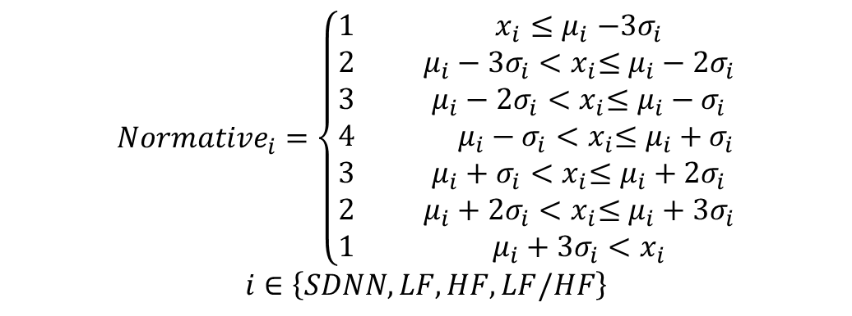
HRV
$${Normative}_{i}=\left\{\begin{aligned}\begin{matrix}1 & & x_{i}{≤μ}_{i}−3σ_{i} \\ 2 & & μ_{i}−{3σ}_{i}{<x}_{i}≤μ_{i}−{2σ}_{i} \\ 3 & & μ_{i}−{2σ}_{i}{<x}_{i}≤μ_{i}−σ_{i}\end{matrix} \\ \begin{matrix}4 & & μ_{i}−σ_{i}{<x}_{i}≤μ_{i}+σ_{i}\end{matrix} \\ \begin{matrix}3 & & μ_{i}+σ_{i}{<x}_{i}≤μ_{i}+{2σ}_{i} \\ 2 & & μ_{i}+2σ_{i}{<x}_{i}≤μ_{i}+3σ_{i} \\ 1 & & μ_{i}+3σ_{i}{<x}_{i}\end{matrix}\end{aligned}\right.$$
$$i∈\left\{SDNN,LF,HF,LF/HF\right\}$$
where μi and σi are parameters of normal distribution transformed from the quartiles of normative data from TABLE IV‑8. xi refers to HRV measurements from sensor data. Normativei values are quantized into four discrete levels in order to illustrate the position of current HRV within the healthy population. This can be used to represent HRV fluctuations when monitored over a long period. A lower value for Normativei indicates dangerous HRV, whereas higher value refers to normal HRV.

Slide 5
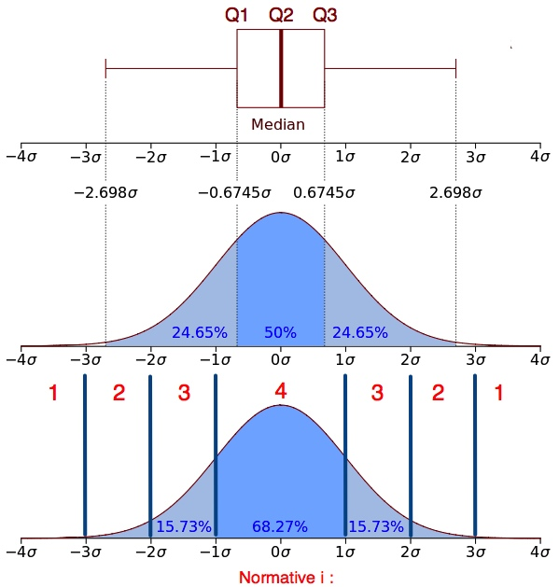
HRV
Figure IV‑4 Relationship between quartile and standard deviation and the quantization of HRV indices

Slide 6
Weight
TABLE IV‑4 Body mass index (BMI) cut-off points for Asian populations
Location | Overweight | Obesity
China | 25 | 30
Hong Kong | 22 | 27
Indonesia | 22 | 27
Japan | 24 | 29
Singapore | 23 | 27
Thailand (urban) | 23 | 28
Thailand (rural) | 25 | 30

Slide 7
Weight
TABLE IV‑5 Classification of body fat percentages among people over 50 years of age in Taiwan
Description | Women | Men
Excellent | < 21 % | < 16 %
Good | 21~26 % | 16~21%
Moderate | 26~31 % | 21~26%
Overweight | 31~36 % | 26~31%
Obese | > 36 % | > 31%

Slide 8

Weight
Two random variables were derived from raw data related to weight and fat: weight loss (WL), which corresponds to unexplained weight loss and obesity (OBS). Unexplained weight loss is defined as a loss of more than 5% of one’s normal weight at time t (WLt), calculated as follows:
where w' is defined as the highest weight measurement in the last tperiod . This period is initially set at 6 months as per expert recommendations [53].
$${WL}_{t}=\left\{\begin{matrix}\left\lceil \frac{{w_{highest}−w}_{t}}{w_{highest}}×100\right\rceil \% & w^{′}>w_{t} \\ 0 & w^{′}≤w_{t}\end{matrix}\right.$$

Slide 9
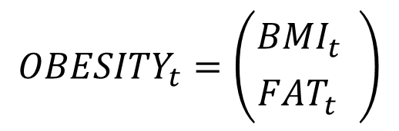

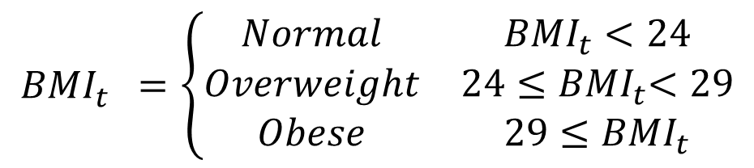
Weight
Thus, OBS at time t (${OBSESITY}_{t}$) comprises two factors:
$${OBESITY}_{t}=\left({{BMI}_{t}^{} \atop {FAT}_{t}^{}}\right)$$
$${BMI}_{t}^{}=\left\{\begin{matrix}Normal & {BMI}_{t}<24 \\ Overweight & 24{≤BMI}_{t}<29 \\ Obese & 29{≤BMI}_{t}\end{matrix}\right.$$
$${FAT}_{t}^{}∈\left\{Excellent, Good, Moderate, Overweight, Obese\right\}$$

Slide 10
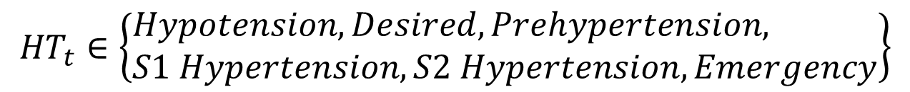
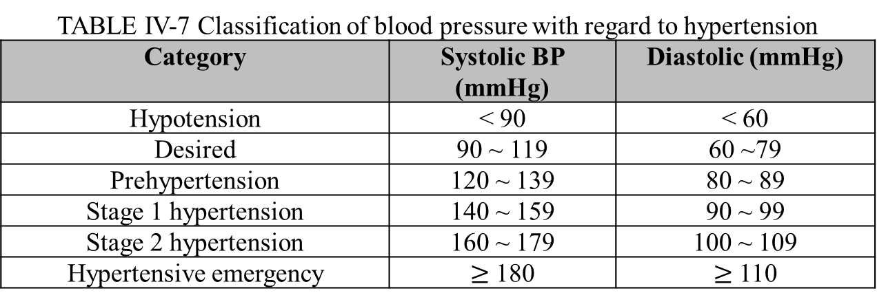
Hypertension
TABLE IV‑7 Classification of blood pressure with regard to hypertension
Category | Systolic BP (mmHg) | Diastolic (mmHg)
Hypotension | < 90 | < 60
Desired | 90 ~ 119 | 60 ~79
Prehypertension | 120 ~ 139 | 80 ~ 89
Stage 1 hypertension | 140 ~ 159 | 90 ~ 99
Stage 2 hypertension | 160 ~ 179 | 100 ~ 109
Hypertensive emergency | $≥$ 180 | $≥$ 110
$${HT}_{t}∈\left\{\begin{aligned}&Hypotension, Desired, Prehypertension, \\ &S1 Hypertension,S2 Hypertension, Emergency\end{aligned}\right\}$$

Slide 11
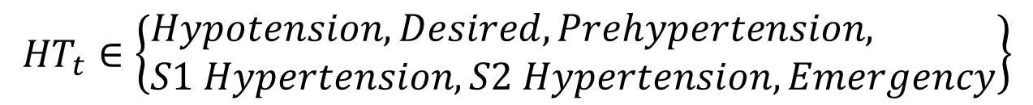
Hypertension
$${HT}_{t}∈\left\{\begin{aligned}&Hypotension, Desired, Prehypertension, \\ &S1 Hypertension,S2 Hypertension, Emergency\end{aligned}\right\}$$
TABLE IV‑8 HRV statistics from healthy subjects in various age groups
HRV Index | 65-74 years (N=146)
SDNN | 26.4 (19.5-35.1)
LF_n.u | 0.73 (0.55-0.83)
HF_n.u | 0.27 (0.17-0.45)
LF/HF | 2.70 (1.22-4.72)
(LF_n.u and HF_n.u. stand for normalized LF and HF by dividing LF+HF.)

Slide 12
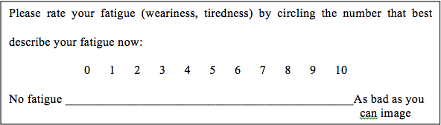

Fatigue
問卷
${FT}_{t}∈\left\{0,1,2,3,4,5,6,7,8,9,10\right\}$

Slide 13

Self-rated Health
問卷
People are asked,“In general, how would you rate your overall health?” The answer scale comprises five levels: Very good, Good, Moderate, Bad and Very bad.
$${SRH}_{t}=\left\{\begin{matrix}\begin{matrix}1 & SRH record=Very Bad \\ 2 & SRH record=Bad \\ 3 & SRH record=Moderate\end{matrix} \\ \begin{matrix} 4 & SRH record=Good \\ 5 & SRH record=Very Good\end{matrix}\end{matrix}\right.$$

Slide 14

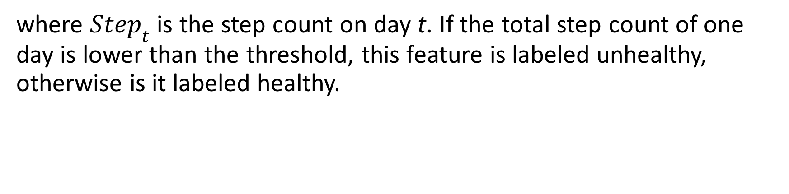
Functional Status
$${HEALTH}_{t}=\left\{\begin{aligned}&\begin{matrix}healthy & {Step}_{t}\end{matrix}>μ_{Step} \\ &\begin{matrix}poor & otherwise\end{matrix}\end{aligned}\right.$$
where ${Step}_{t}$ is the step count on day t. If the total step count of one day is lower than the threshold, this feature is labeled unhealthy, otherwise is it labeled healthy.

